Slide 1
stylus
Hardware device

Slide 2


Slide 3
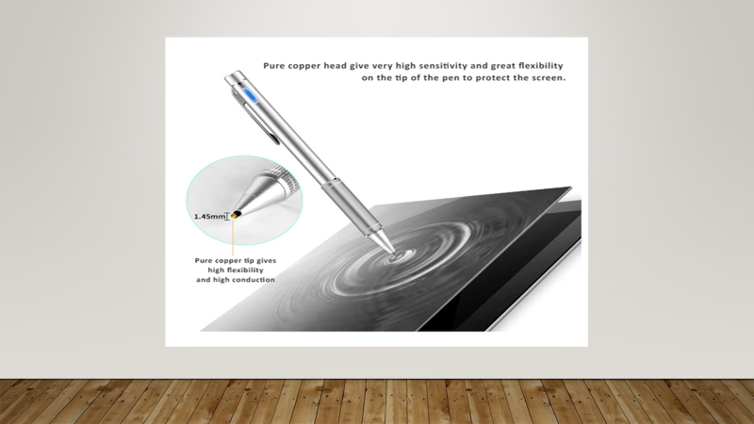
Tip specifications

Slide 4
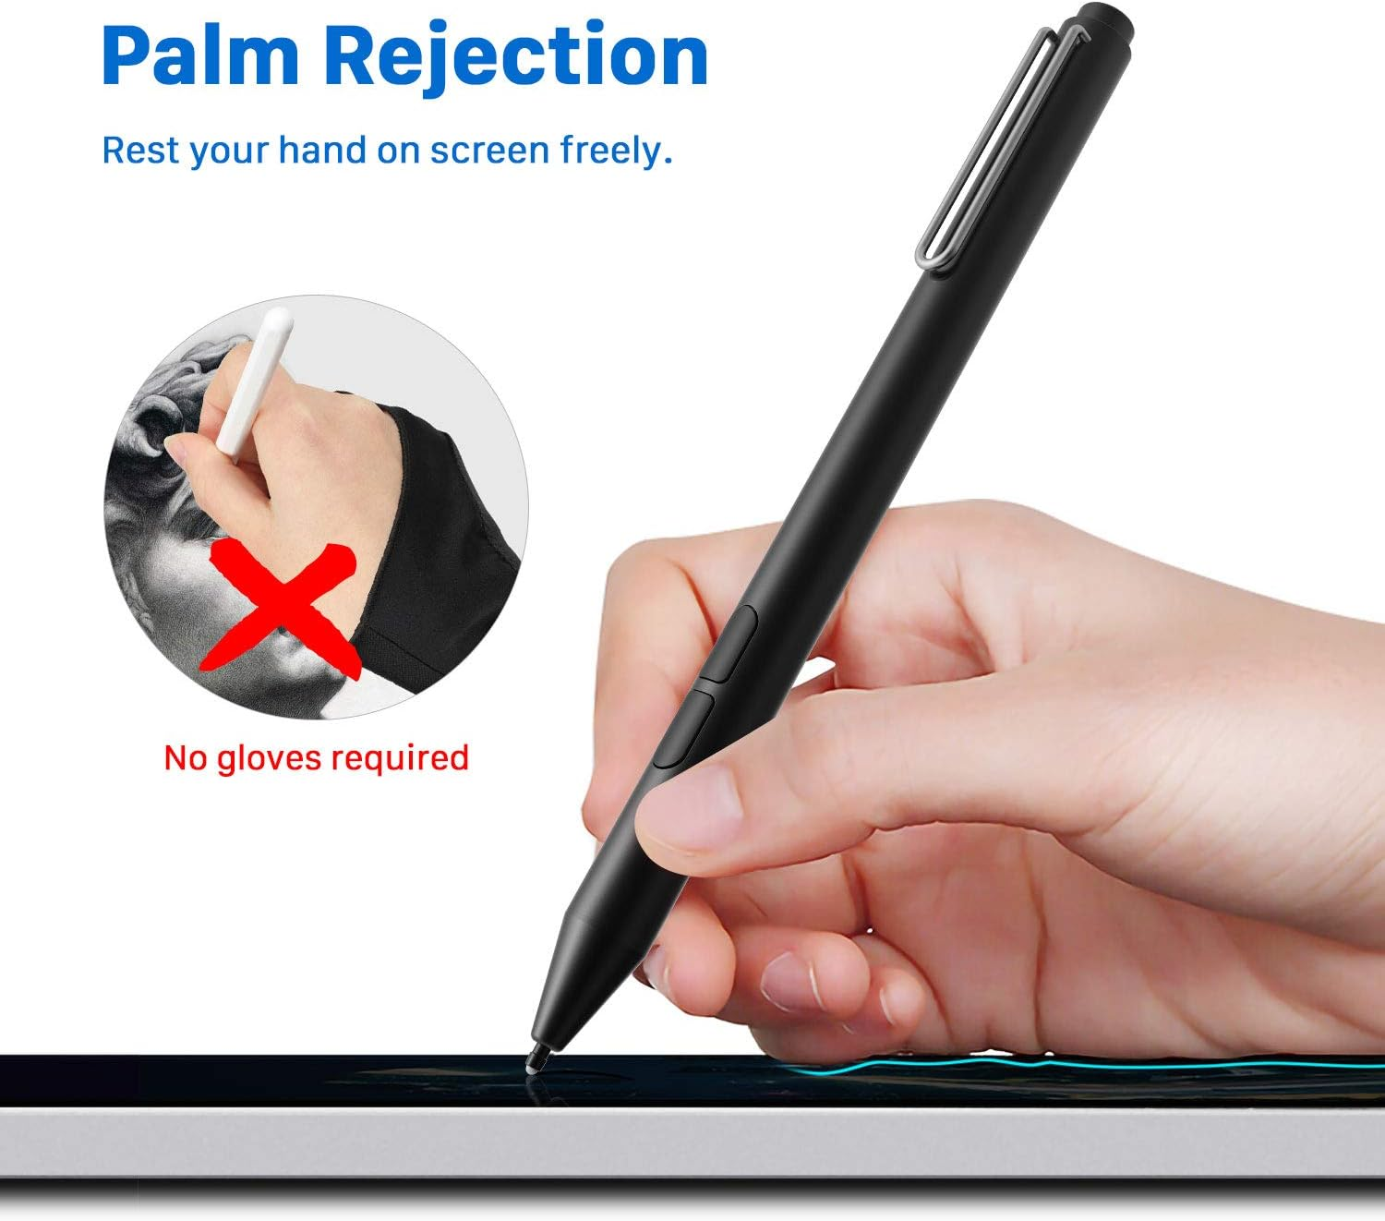
Only sence the tip of stylus while using.

Slide 5
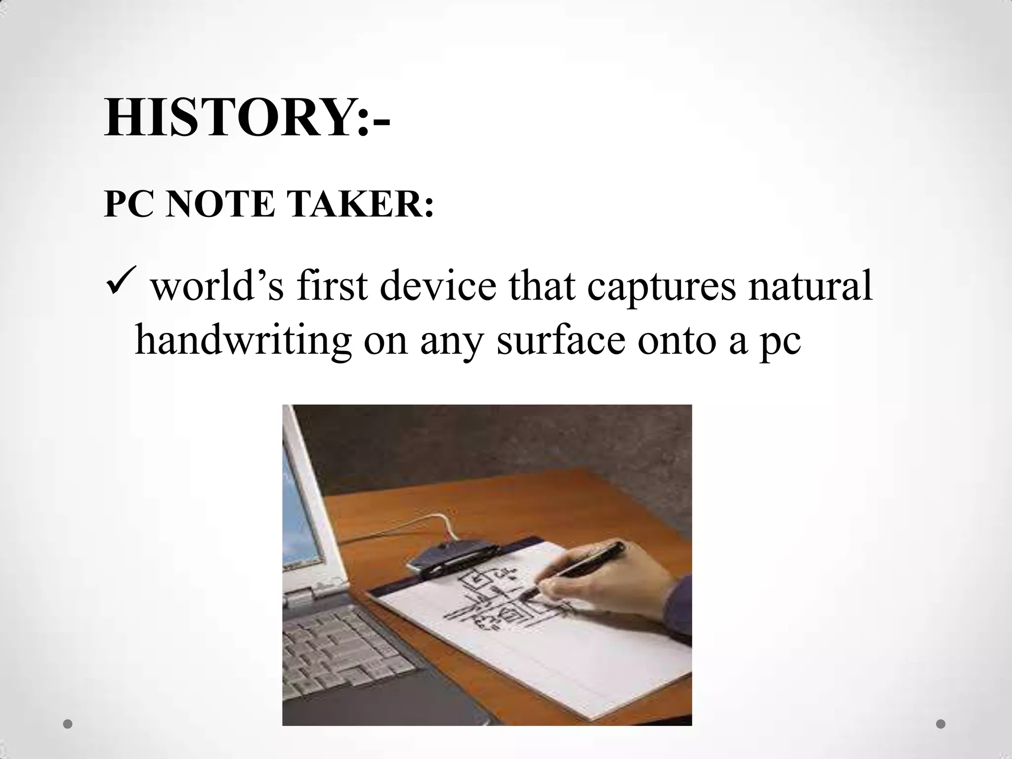

Slide 6
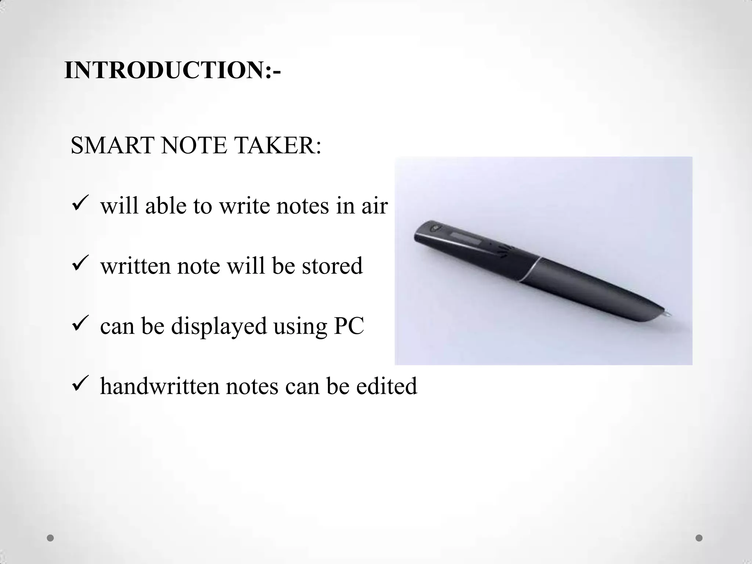

Slide 7


Slide 8
